Slide 1
DekGEWASSE
Canola Inligtingsdag Hopefield – 28 Mei 2021
Dr JA Strauss & L Smorenburg & C Viljoen

Slide 2
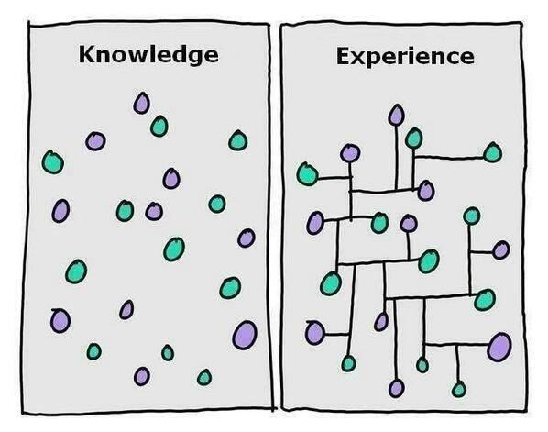

Slide 3
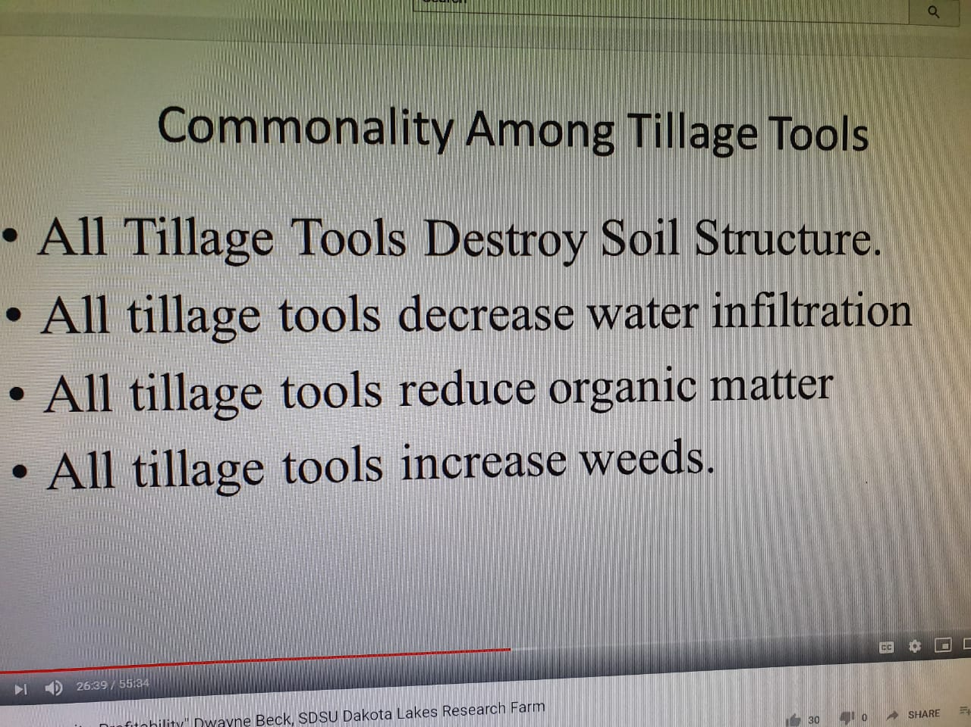

Slide 4
Herbicide amount, N fertiliser amount, and N source diversity were also significantly related to weed abundance and diversity
Herbicide amount =
increased abundance
Herbicide amount =
decreased diversity

Slide 5
Fertiliser amount =
increased abundance
Fertiliser amount =
decreased diversity
N source diversity =
decreased abundance
N source diversity =
increased diversity

Slide 6
Dekgewas tipes
Grane/grasse
  Biomassa en bedekking en wortelmassa
Peule
  Natuurlike N verniet
Brassicas
  Voedingstof hersirkulering
Blomme
  Lok bestuiwers
  Predatore

Slide 7
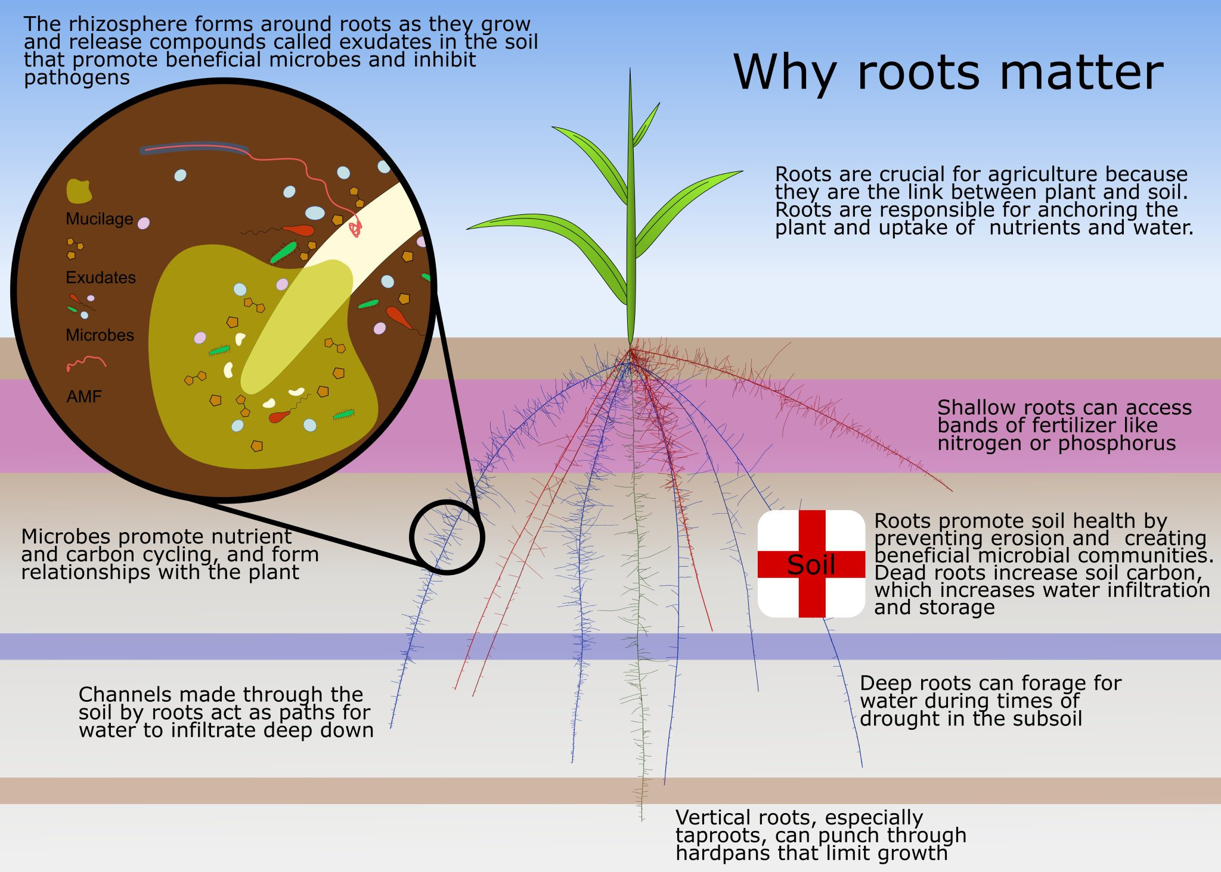

Slide 8
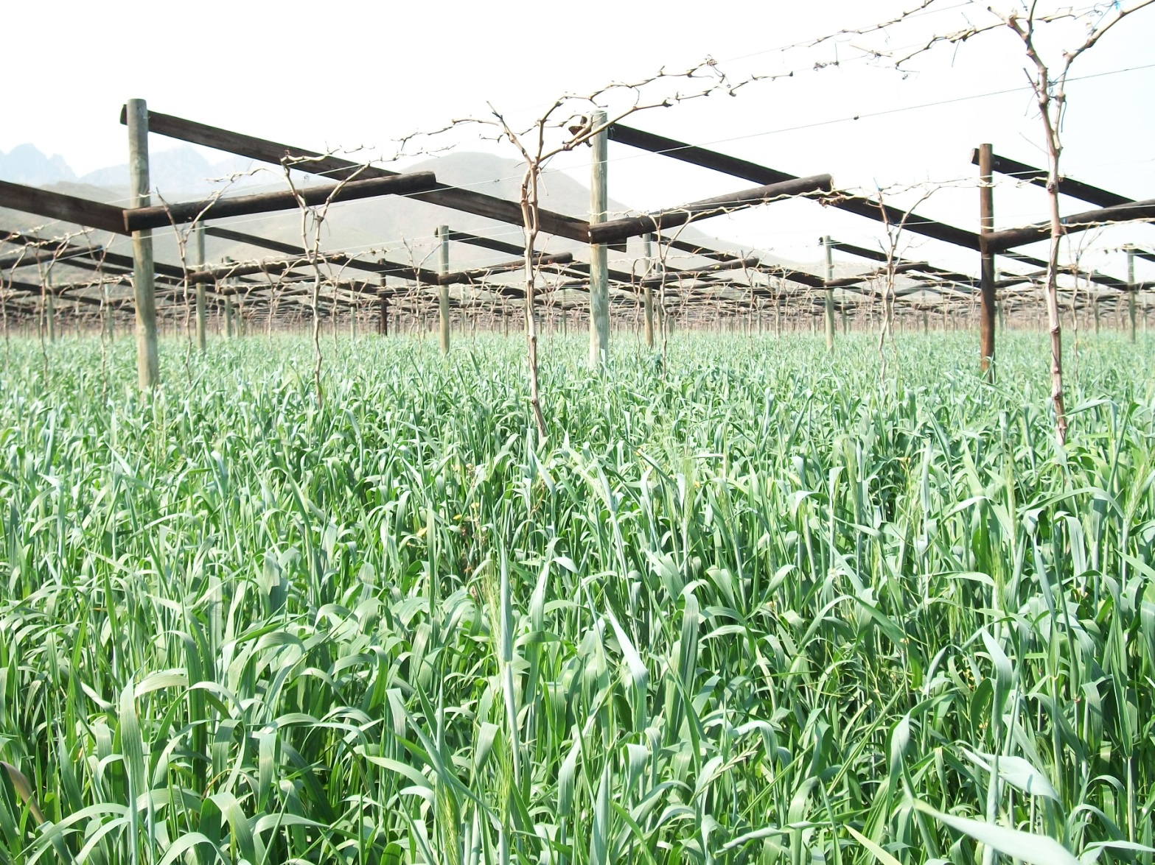

Slide 9
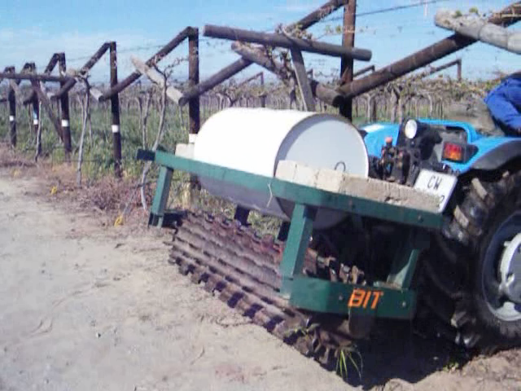

Slide 10
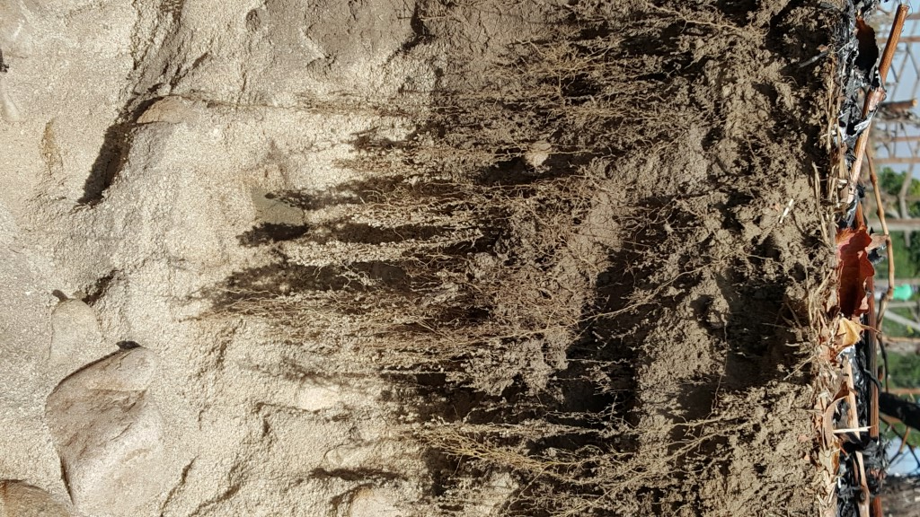
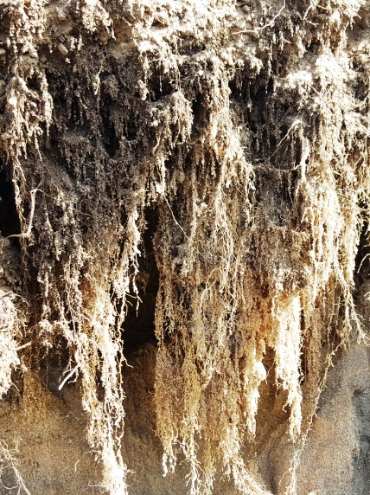

Slide 11
Treatment |  | Species |  | Seeding rate
 |  |  |  |  |  |  |  |  |  |  |  | 11. | Saia oats | 8
1. | Spring rye | 15 | 4. | Saia oats | 10 | 6. | Forage barley | 20 |  |  |  |  | Forage Oats | 8
 | Woolly Vetch | 15 |  | Woolly Vetch | 10 |  | Berseem clover | 5 |  |  |  |  | Stooling rye | 8
2. | Field peas | 40 |  | Faba beans | 40 |  | Phacelia | 2 | 8. | Field peas | 40 |  | Barley | 8
 | Spring rye | 15 | 5. | Spring rye | 7 |  | Fodder radish | 1 |  | Spring rye | 15 |  | Field peas | 8
3. | Spring rye | 10 |  | Woolly vetch | 10 | 7. | Crimson clover | 5 |  | White Clover | 5 |  | Woolly Vetch | 2
 | Woolly Vetch | 10 |  | Field peas | 25 |  | Stooling rye | 10 | 9. | Saia oats | 50 |  | Japanese Radish | 1
 | Lupins | 40 |  | White mustard | 1 |  | Japanese radish | 2 | 10. | Bare Plot (weeds) |  |  | Tillage radish | 1
 |  |  |  |  |  |  |  |  |  |  |  |  | Black rape | 1
 |  |  |  |  |  |  |  |  |  |  |  | 13. | Wheat | 80

Slide 12
2020 Bio massa
3 Rye 10kg/ha + Vetch 10kg/ha + Bitter Lupien 40kg/ha
9 Saia 50kg/ha

Slide 13
2020 Onkruid %

Slide 14
Treatment |  | Species |  | Seeding rate
 |  |  |  |  |  |  |  |  |  |  |  | 11. | Saia oats | 8
1. | Spring rye | 15 | 4. | Saia oats | 10 | 6. | Forage barley | 20 |  |  |  |  | Forage Oats | 8
 | Woolly Vetch | 15 |  | Woolly Vetch | 10 |  | Berseem clover | 5 |  |  |  |  | Stooling rye | 8
2. | Field peas | 40 |  | Faba beans | 40 |  | Phacelia | 2 | 8. | Field peas | 40 |  | Barley | 8
 | Spring rye | 15 | 5. | Spring rye | 7 |  | Fodder radish | 1 |  | Spring rye | 15 |  | Field peas | 8
3. | Spring rye | 10 |  | Woolly vetch | 10 | 7. | Crimson clover | 5 |  | White Clover | 5 |  | Woolly Vetch | 2
 | Woolly Vetch | 10 |  | Field peas | 25 |  | Stooling rye | 10 | 9. | Saia oats | 50 |  | Japanese Radish | 1
 | Lupins | 40 |  | White mustard | 1 |  | Japanese radish | 2 | 10. | Bare Plot (weeds) |  |  | Tillage radish | 1
 |  |  |  |  |  |  |  |  |  |  |  |  | Black rape | 1
 |  |  |  |  |  |  |  |  |  |  |  | 13. | Wheat | 80

Slide 15
Early graze compared to later graze
Total dry matter per mix
Department of Agriculture
No | 06-Aug | 29-Sep
25 | 1912,2 | 4353,1
26 | 2265,3 | 3806,1
27 | 2530,6 | 7187,8
28 | 2626,5 | 5087,8
29 | 2365,3 | 5057,1
30 | 2569,4 | 5822,4
31 | 1457,1 | 3355,1
32 | 2708,2 | 4463,3
33 | 2589,8 | 5379,6
34 | 2051,0 | 3285,7
35 | 2293,9 | 5349,0
Ave | 2306,3 | 4831,5
3 Rye 10kg/ha + Vetch 10kg/ha + Bitter Lupines 40kg/ha

Slide 16
Early graze compared to later graze
Mix numbers
Weed % of dry matter
No | 06-Aug | 29-Sep
25 | 19,4 | 13,9 | 1
26 | 12,5 | 23,8 | 2
27 | 7,1 | 0,3 | 3
28 | 8,2 | 4,3 | 4
29 | 1,6 | 3,5 | 5
30 | 4,4 | 1,4 | 6
31 | 5,5 | 4,3 | 7
32 | 8,4 | 1,6 | 8
33 | 6,9 | 0,0 | 9
34 | 6,3 | 0,0 | 11
35 | 11,4 | 12,8 | 13
Ave | 8,34 | 5,98

Slide 17
2016-2020 Tygerhoek
Total dry matter per mix
 | Tygerhoek
No | 2016 | 2017 | 2018 | 2019 | 2020
1 | 5579,3 | 2779,2 | 4798,0 | 1014,5 | 6706,2
2 | 5413,6 | 2959,7 | 7163,9 | 1927,0 | 6185,1
3 | 5526,5 | 2917,9 | 4586,7 | 1702,9 | 5978,5
4 | 4474,5 | 3290,8 | 6692,9 | 979,3 | 4254,9
5 | 3410,5 | 3191,4 | 6304,1 | 1705,4 | 4265,9
6 | 4274,5 | 2811,7 | 5983,3 | 858,3 | 6330,0
7 |  | 1751,9 | 3101,7 | 647,4 | 4656,3
8 |  | 3532,7 | 6544,2 | 1876,0 | 6555,7
9 |  | 3087,1 | 9485,4 | 840,8 | 7726,7
10 |  | 3050,0 | 3616,0 | 773,1 | 4937,0
11 |  |  | 8075,2 | 1236,7 | 6400,7
13 |  |  | 5308,5 | 996,0 | 7573,8
Ave | 4385,0 | 2853,6 | 5667,5 | 1275,1 | 5660,8

Slide 18
2016-2020 Tygerhoek
Weed % of dry matter
 | Tygerhoek
No | 2016 | 2017 | 2018 | 2019 | 2020
1 | 0,4 | 41,1 | 8,4 | 16,4 | 20,1
2 | 0,0 | 31,9 | 23,1 | 3,6 | 25,8
3 | 0,3 | 45,4 | 25,5 | 12,6 | 31,2
4 | 0,3 | 34,5 | 23,9 | 23,1 | 52,6
5 | 1,0 | 30,2 | 5,1 | 7,6 | 19,8
6 | 0,4 | 42,4 | 5,6 | 15,2 | 7,3
7 |  | 58,8 | 7,6 | 34,5 | 23,8
8 |  | 49,4 | 21,3 | 8,7 | 13,1
9 |  | 0,0 | 13,0 | 8,7 | 2,5
10 |  | 29,2 | 94,9 | 75,2 | 97,1
11 |  |  | 6,2 | 23,8 | 5,4
13 |  |  | 33,1 | 11,3 | 13,1
Ave | 0,4 | 36,3 | 22,3 | 20,1 | 26,0

Slide 21
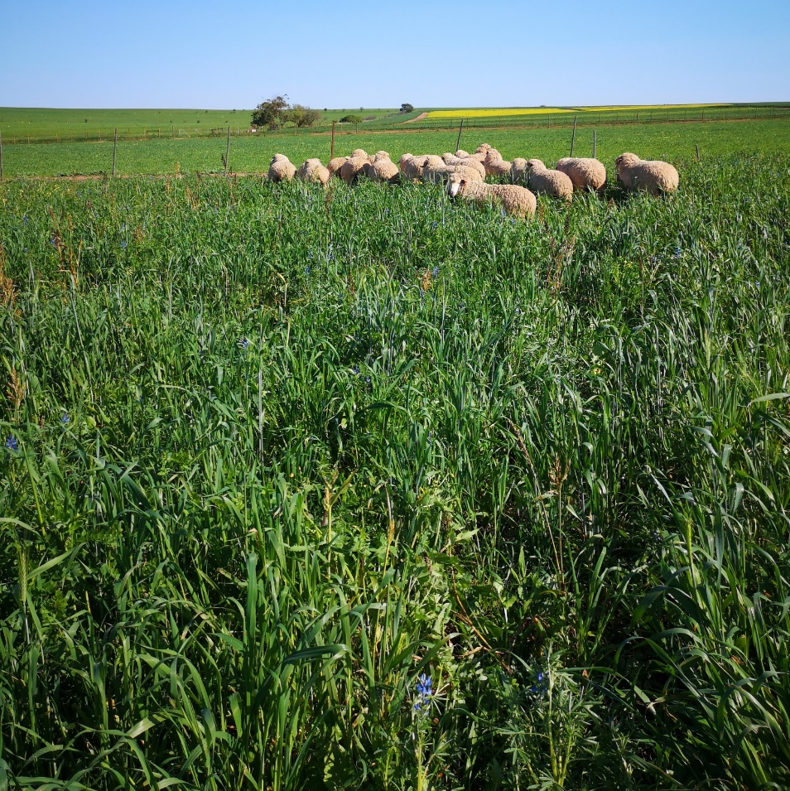
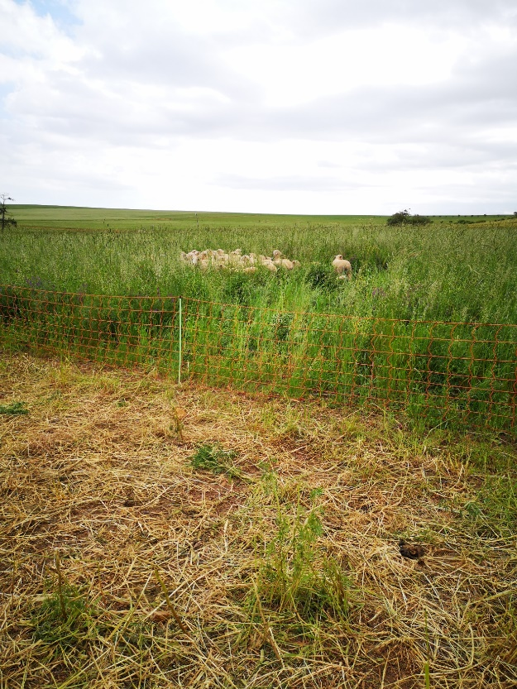
Winter cover crops with sheep
Planted cover crops 29 April @ 40 kg/ha
  Camp divided into 7. 1200m² each
  Start grazing 15 July
  20 Sheep (166 SSU/ha) 3-4 days
  40 Sheep (332 SSU/ha) 2-3 days
  Remove sheep and cut cover. 12 Oct
  3,9 t/ha & 2,6 t/ha dry material left to bale

Slide 22
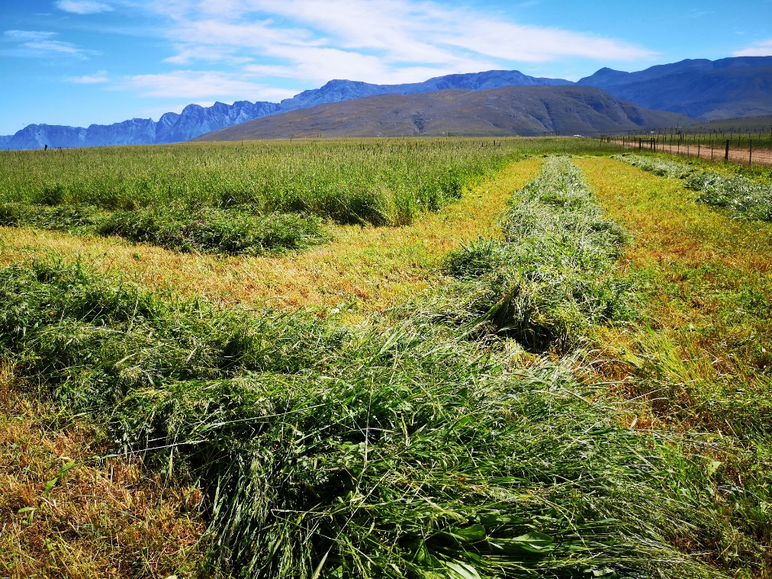
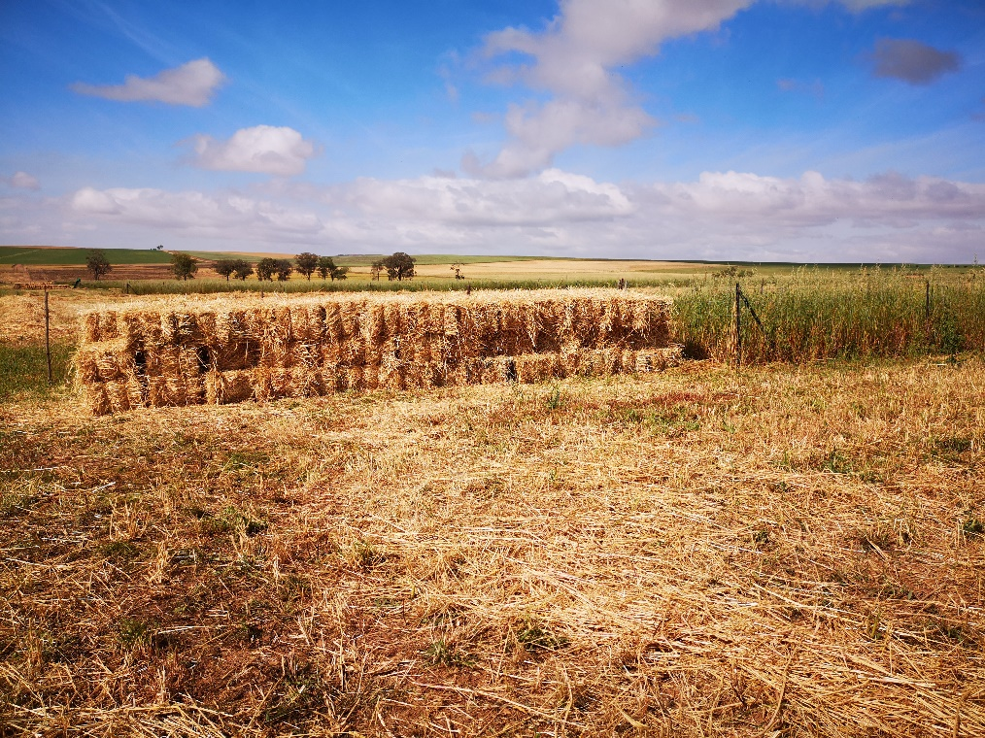
Winter cover cut & baled

Slide 23


Slide 24
Johann Strauss
Direktoraat Plantwetenskappe
021 8085479
021 8085331
johannst@elsenburg.com

