Slide 1


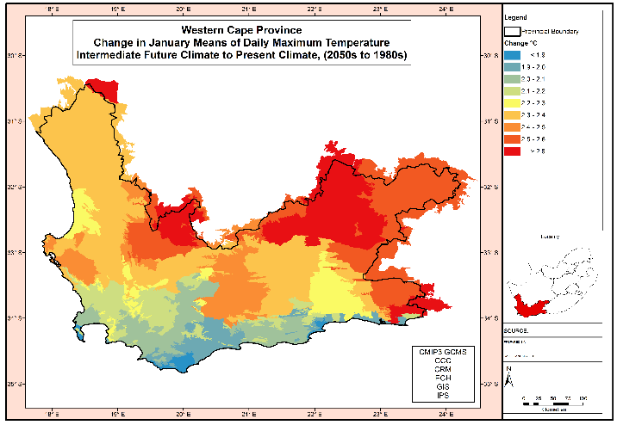

A roadmap to a low-carbon and climate change resilient agriculture
SmartAgri implementation
Elsenburg
Prof Stephanie Midgley

Slide 2
A roadmap to a low-carbon and climate change resilient agriculture
Klimaatsverandering en Risikobestuur
Canola Inligtingsdag, Hopefield, 18 Februarie 2021

Slide 3
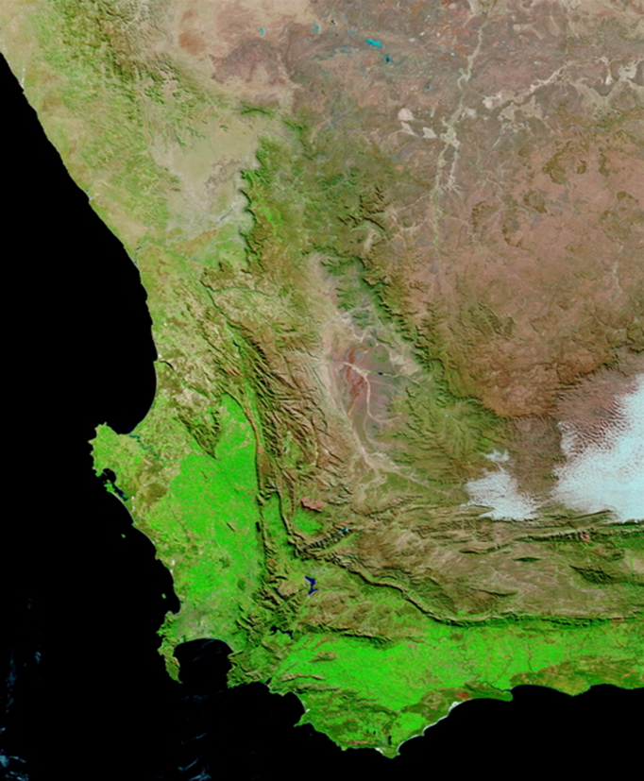
Climate Change: a game changer?
  Climate change is an emergency, and requires urgent action
  We must achieve net zero greenhouse gas emissions by 2050
  The foundation for our response must lie in regeneration of our landscape, soils and rivers
  Economic growth will need to be climate change-proof
  Climate change responses must be fair and inclusive,
  and place the needs of people and communities first
  Government must lead implementation through
  good governance and climate leadership
  In partnership with farmers, the value chain,
  and commodity organizations

Slide 4
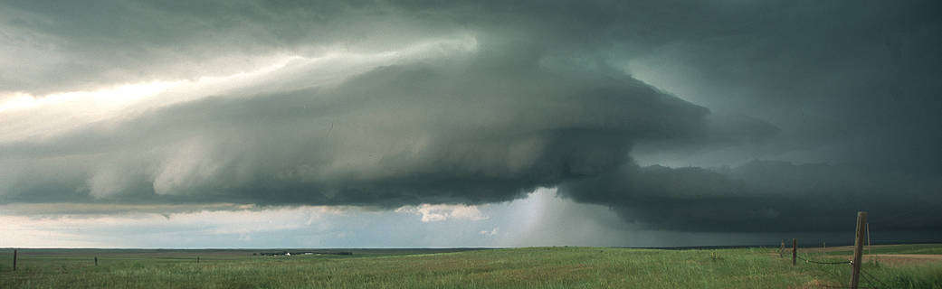
Overview of presentation
  Overview of observed climate trends, and future projections (2040-2060)
  Risk and impacts on agriculture – focus on dryland crops
  Response – renewed and deeper implementation of the SmartAgri Plan

Slide 5
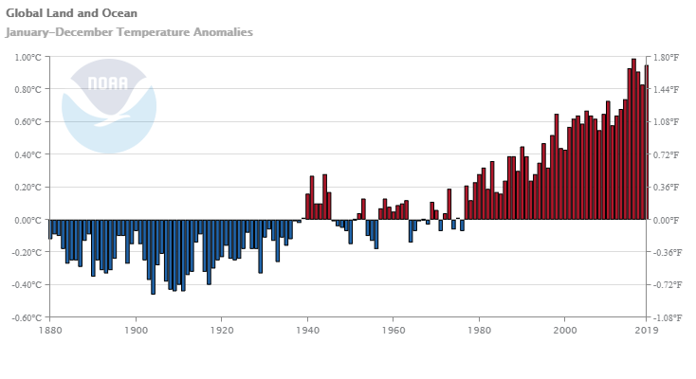
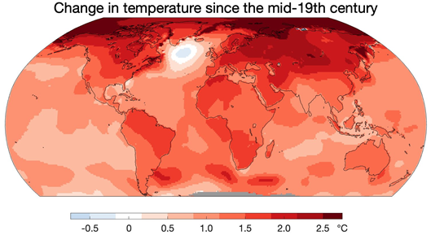
Observed global temperature trends
Gradual warming
BUT
Greater warming in some regions

Slide 6
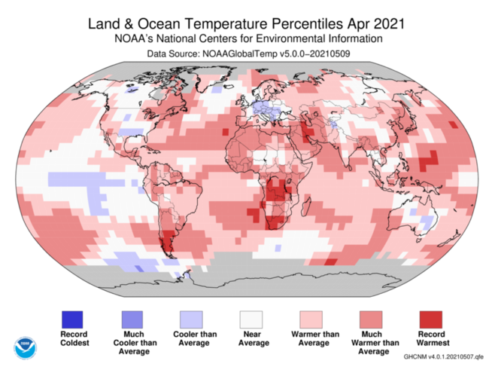
Greater warming in certain months/seasons

Slide 7
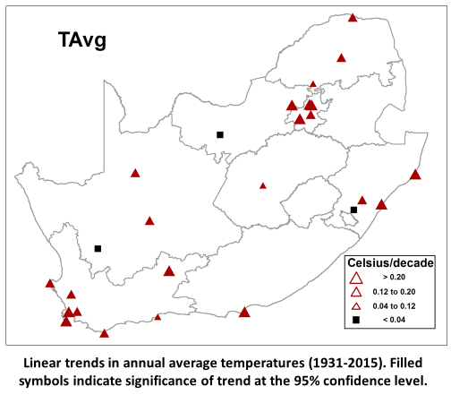
South Africa: Increasing annual avg temp (1931-2015)
Annual average temperature across SA has increased by ca. 0.14°C per decade
The global rate of increase is ca. 0.10°C per decade
Update 2021: 0.12°C per decade
DEA: SA Third National Communication to the UNFCCC (2018)

Slide 8
South Africa: Total annual rainfall (1921-2015)
For most seasons there is no large-scale spatial coherence in statistically significant trends.
Positive trends in annual rainfall totals over the southern interior is reflected mostly in the summer rainfall trends, which is the main rainfall season for this region.
DEA: SA Third National Communication to the UNFCCC (2018)

Slide 9
Western Cape climate shifts: 1960 - 2010
  Rising temperatures (>1°C warming)
  Higher max/min temperatures
  More hot days
  Mean annual rainfall: no overall trends (mostly)
  Some stations show some trends in rainfall in some months
  Reduction in rain days in Jan-April and August
  Increase in rain days in Nov-Dec in the west
  Possible shift toward later start of rainy season and a wetter late season
  Climate trends analysis currently being updated

Slide 10
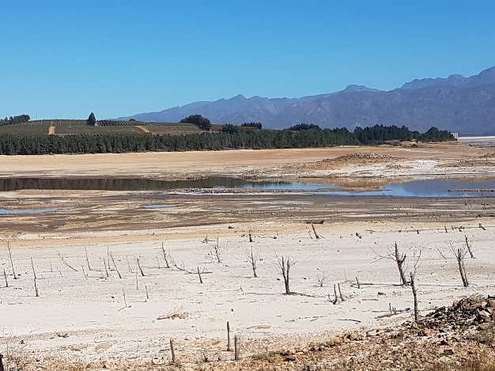
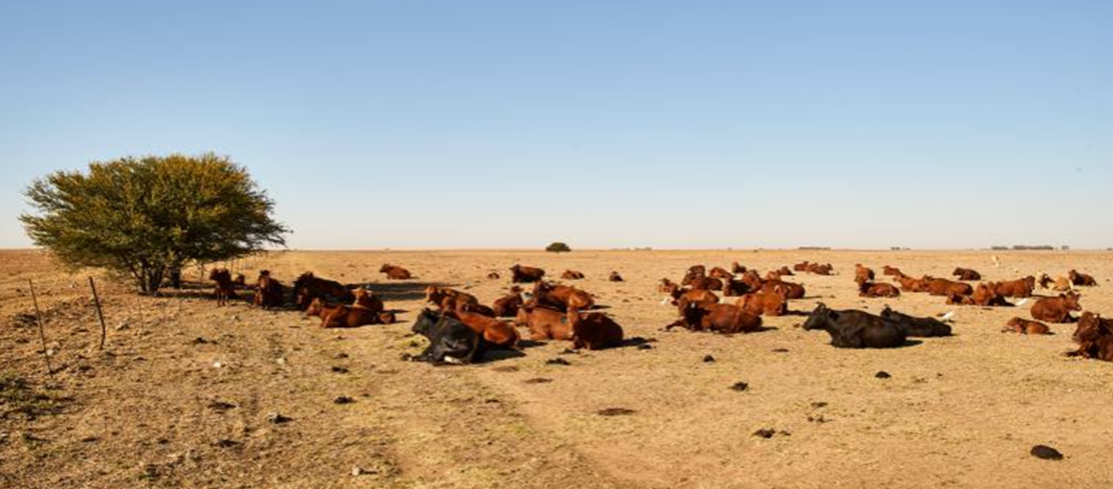
Climate disasters: the 2015-2018 drought
  Worst drought in at least 300 years
  More frequent and multi-year droughts may be part of a changing climate in the Western Cape
  The drought was 3x more likely as a result of climate change
  Huge learning curve for the sector

Slide 11
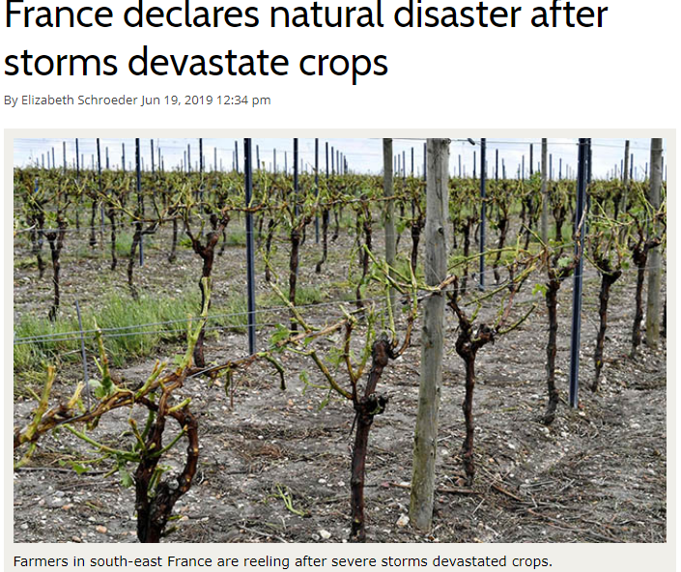
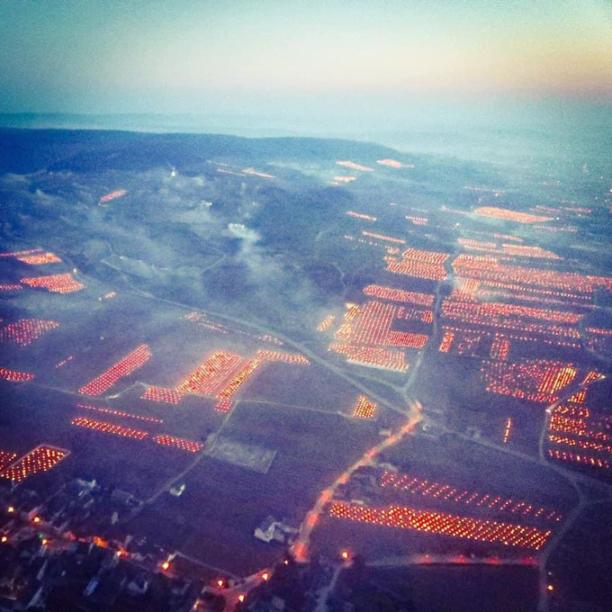
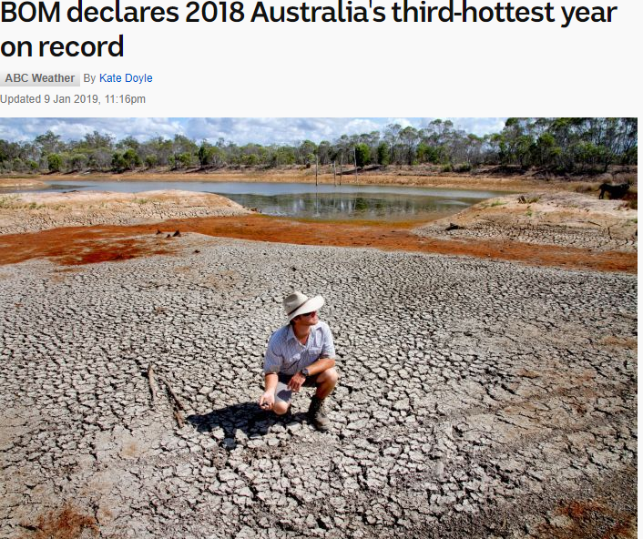
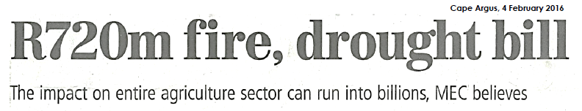
Climate disasters are increasing
Burgundy April 2021 – severe frost
SOUTH AFRICA 2016

Slide 12
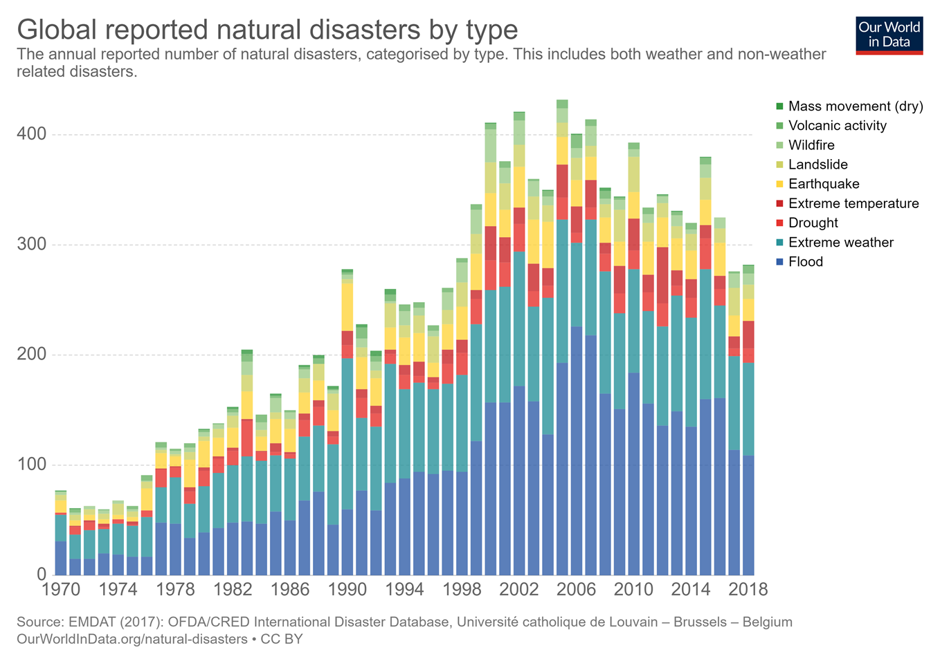
Climate disasters are increasing: 1970 - 2018

Slide 13
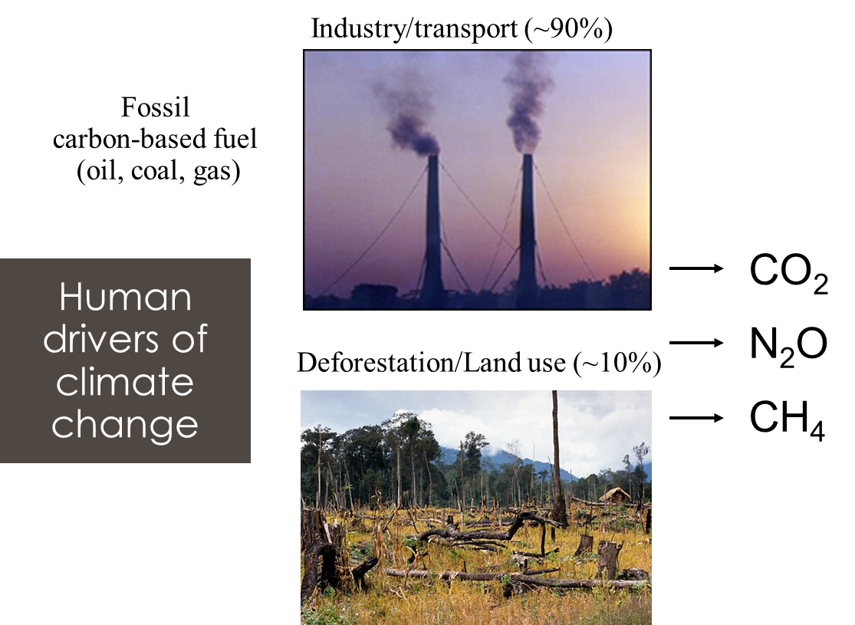
Human drivers of climate change

Slide 14
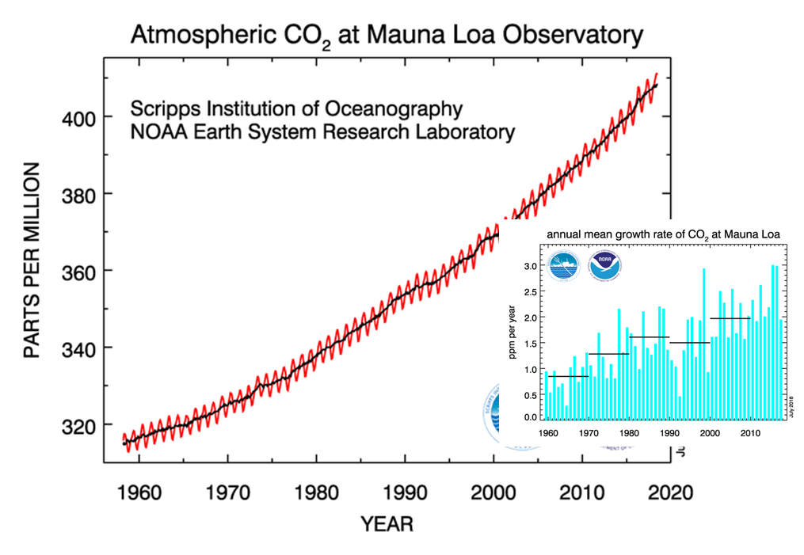
Measured atmospheric CO₂ concentration

Slide 15
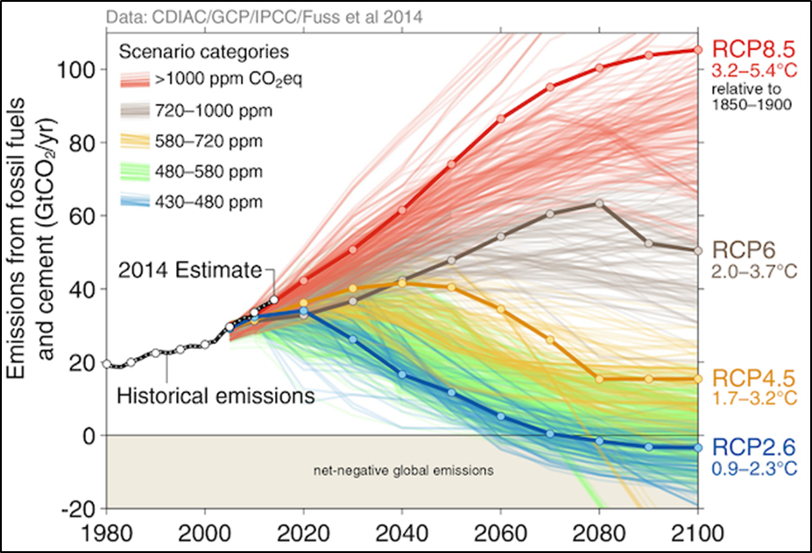
Model projections of future warming (target <1.5°C)
Intergovernmental Panel on Climate Change 2014

Slide 16
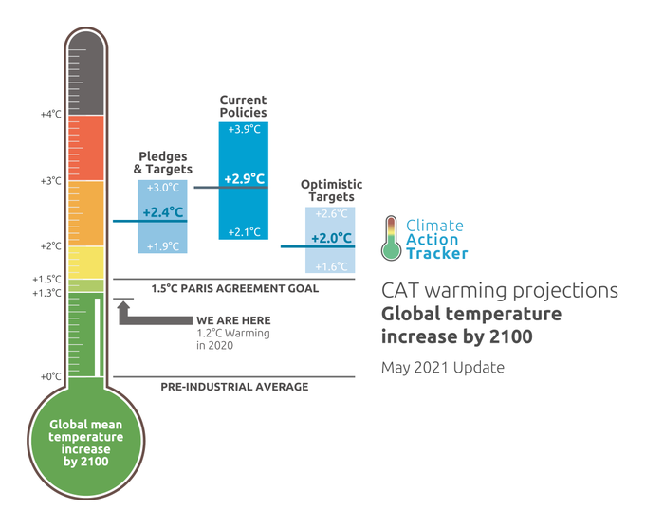
Where are we currently heading? – Climate Action Tracker

Slide 17
Western Cape future climate – system changes
  Locally important climate systems are expected to change: a southward (poleward) shift of the westerly winds will block the movement of rain-bringing cold fronts making landfall.
  Projected changes in rainfall are more uncertain than for temperature.
  There is scientific consensus that the Western Cape will become relatively drier in the longer term as the climate system adjusts.
  Amount of rainfall change cannot be projected yet.
  These trends will emerge by mid-century and beyond, but will already be experienced as increasing inter- and intra-annual rainfall variability over the next 20-30 years.
  More frequent severe weather.

Slide 18
Western Cape summary of climate projections: 2050
  Warming: 1.5°C - 3°C by 2050, lower range along coast
  More hot days and nights, fewer cold days and nights
  Reductions in winter rainfall across the province (greater certainty in the western regions)
  More frequent and longer dry spells
  Possibly more rain on windward mountain slopes in autumn and spring
  Strong likelihood of more intense rainfall events
  More favourable conditions for wildfires
  Projections currently being updated

Slide 19
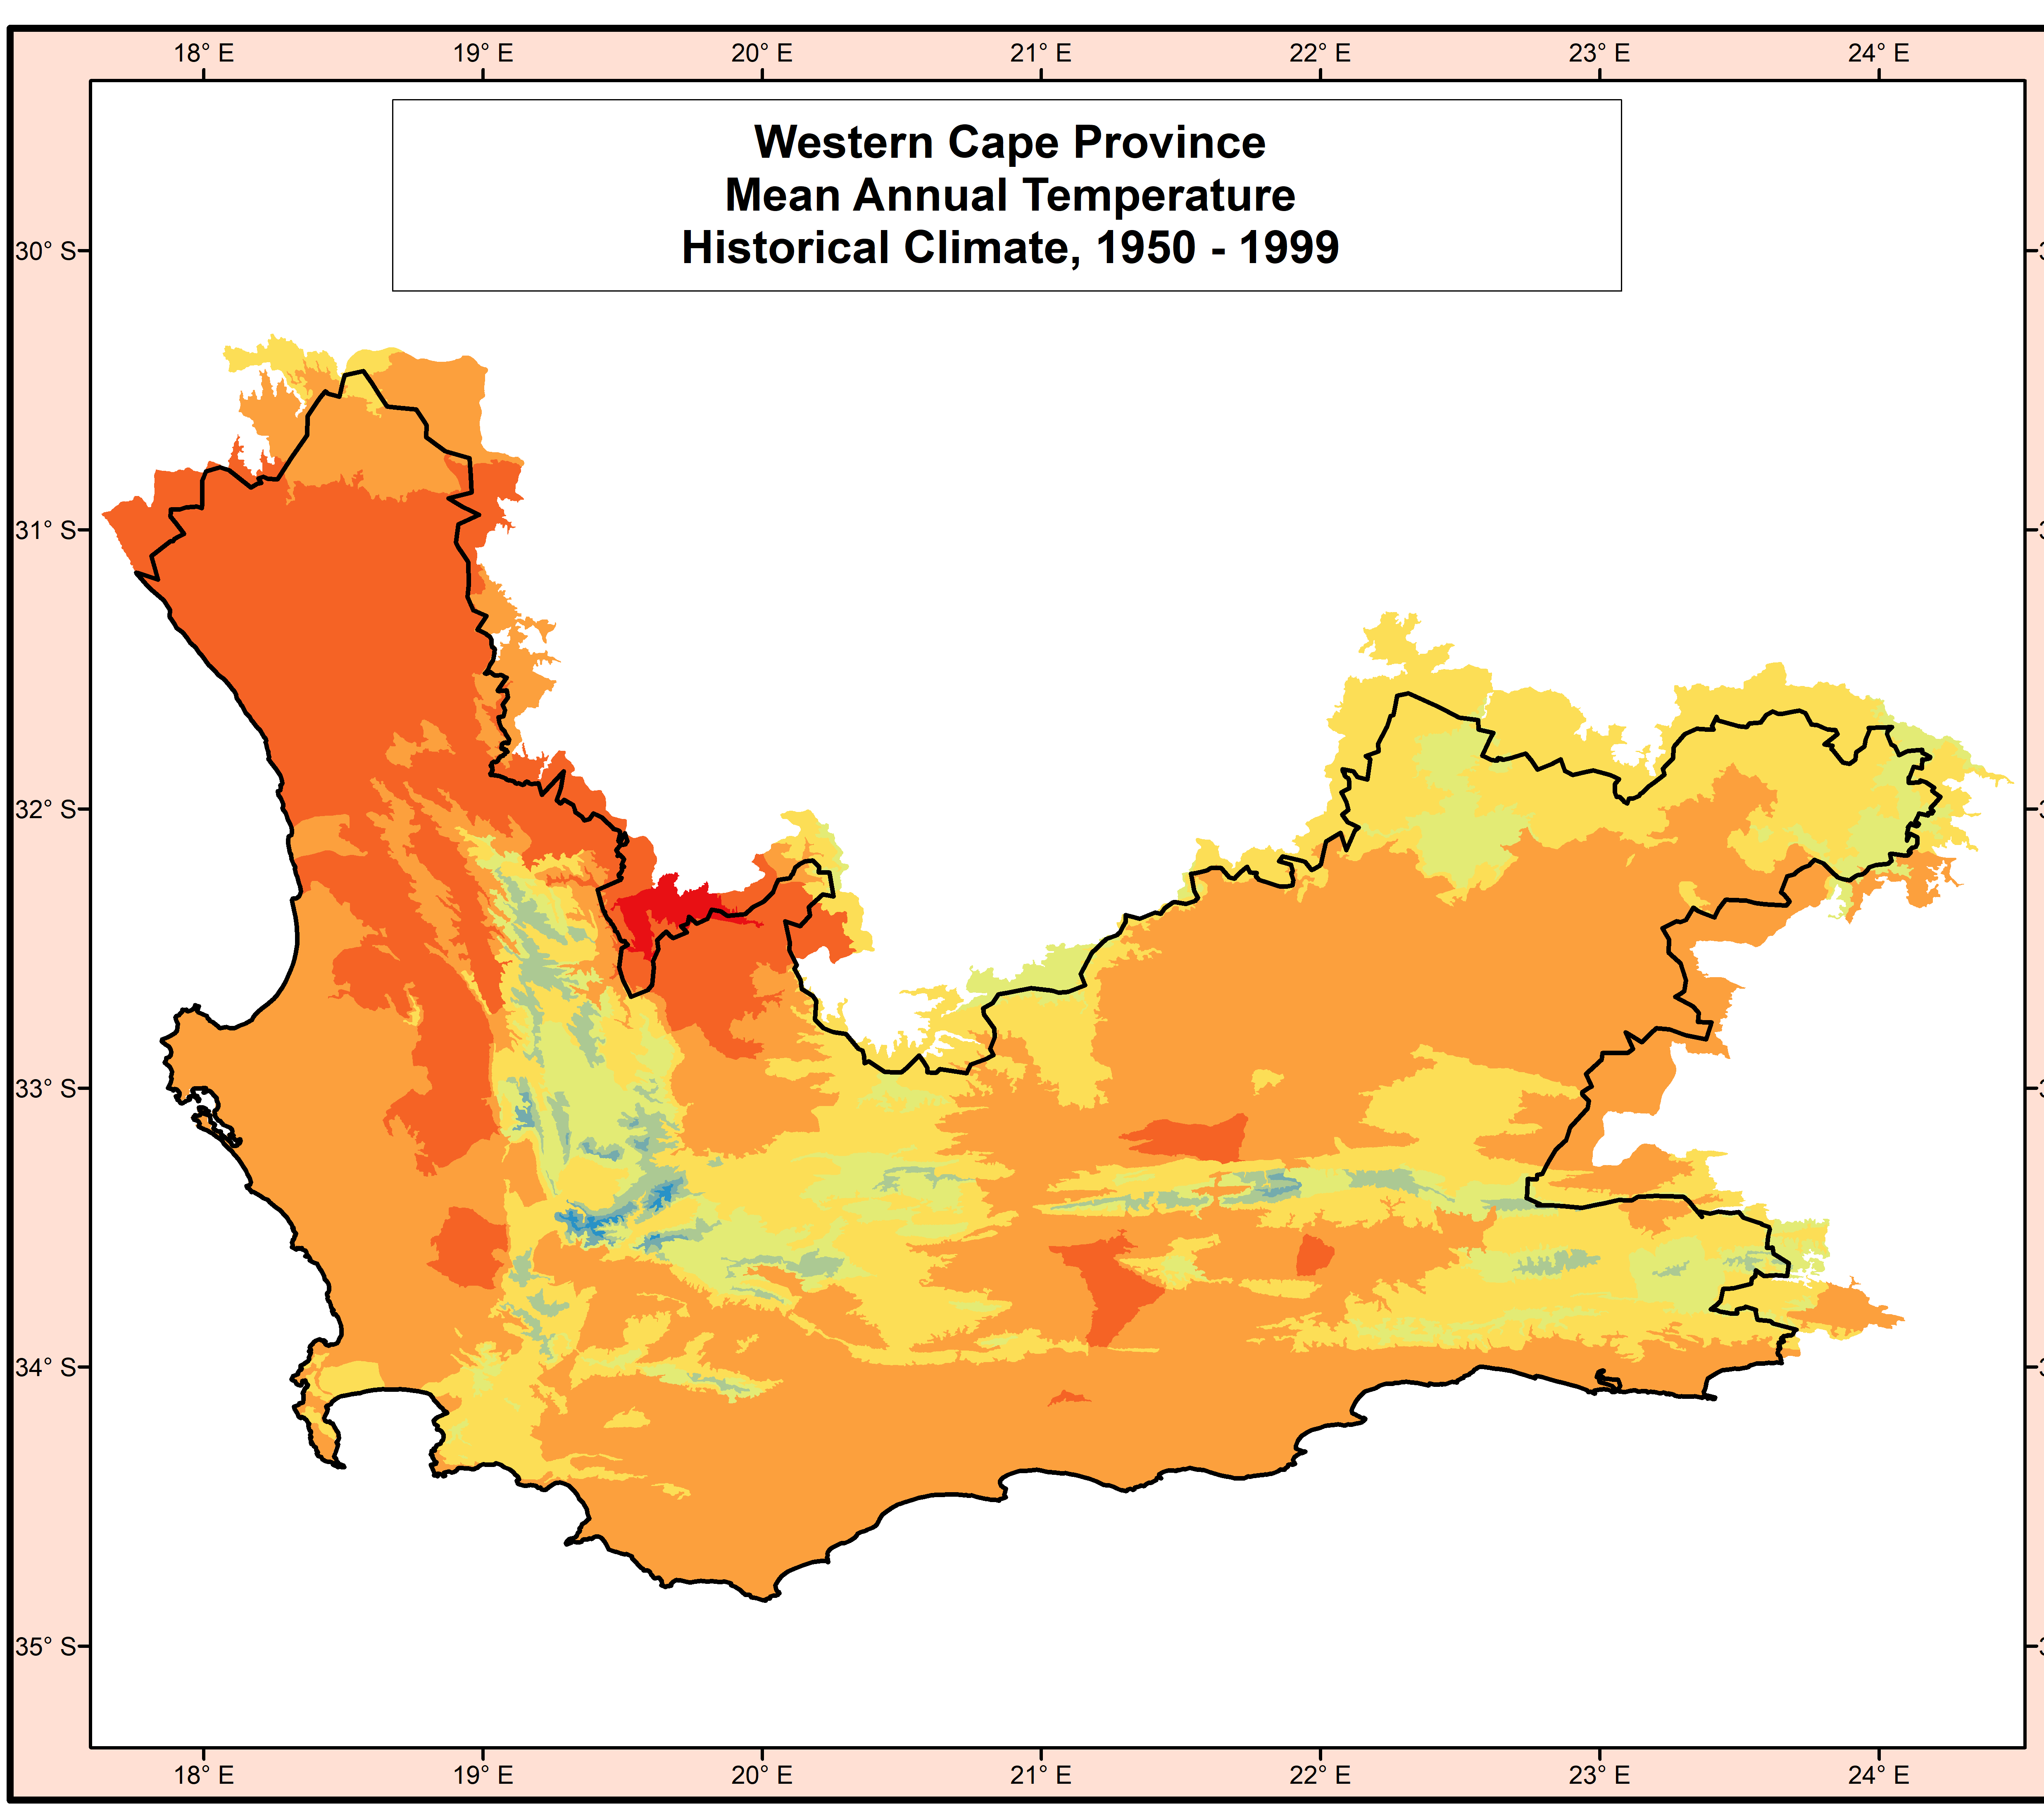
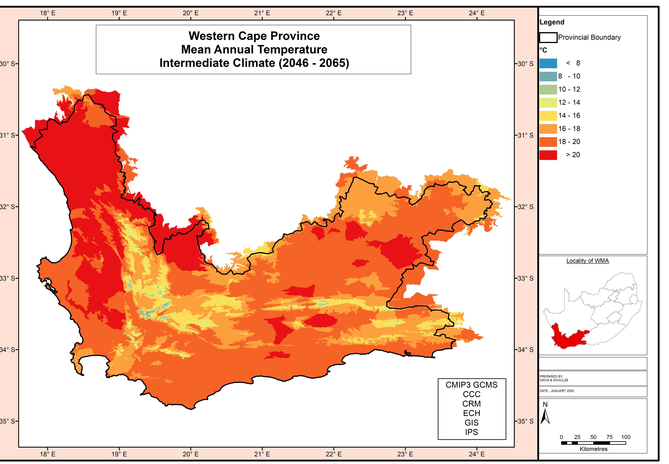
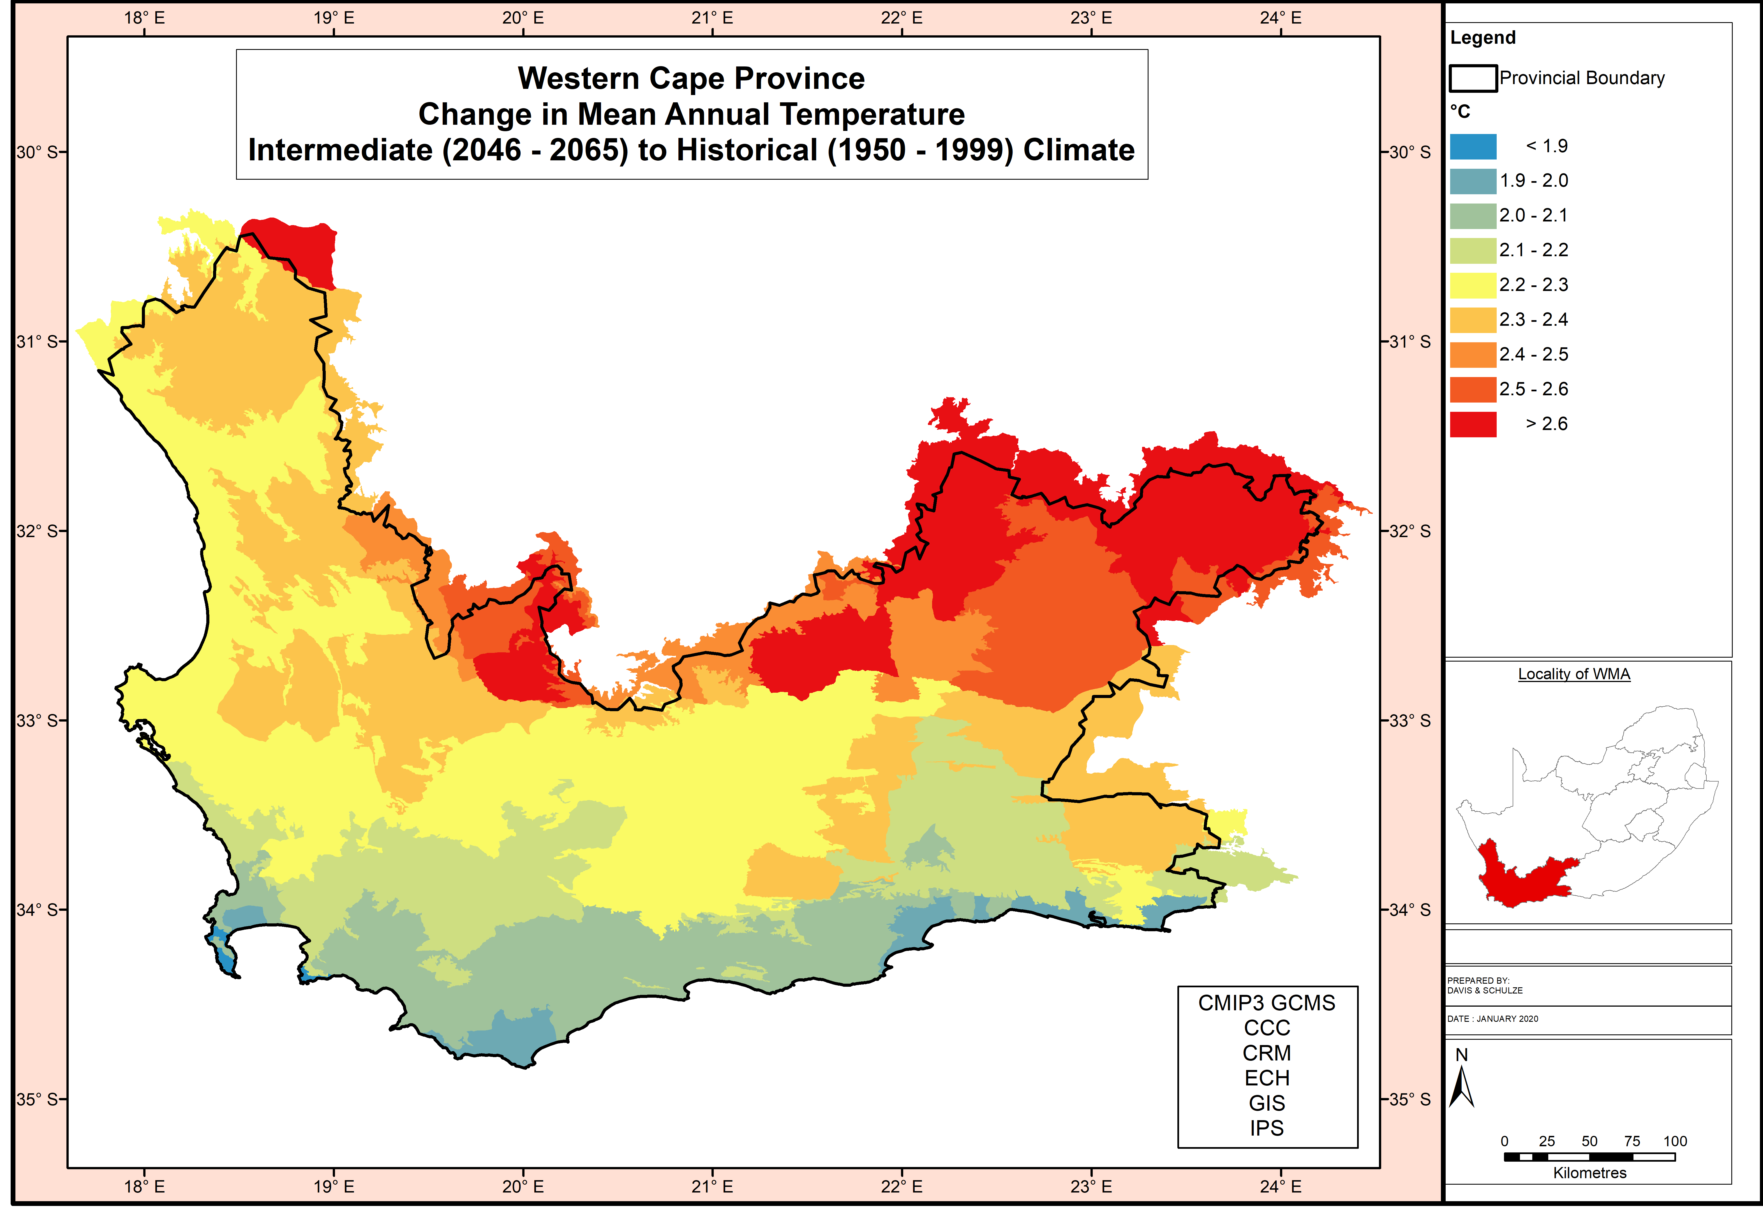
Modelled Mean Annual Temperature (6 models)
Annual temperatures are the integrator of both diurnal and seasonal temperature differences and serve as a very broad indicator of agricultural potential and crop suitability.

Slide 20
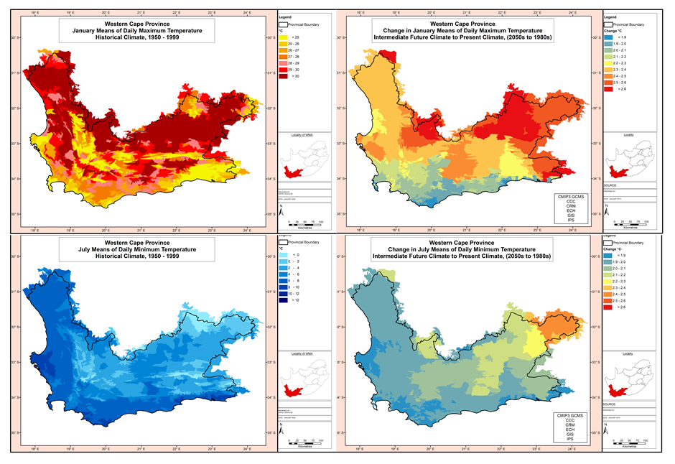
Modelled Tmax (January), Tmin (July) (6 models)

Slide 21
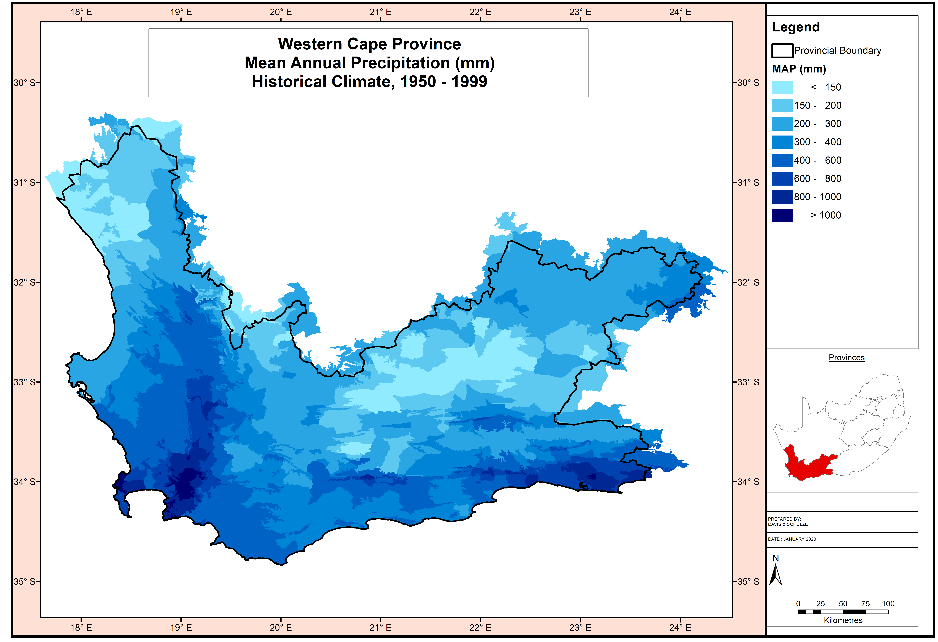
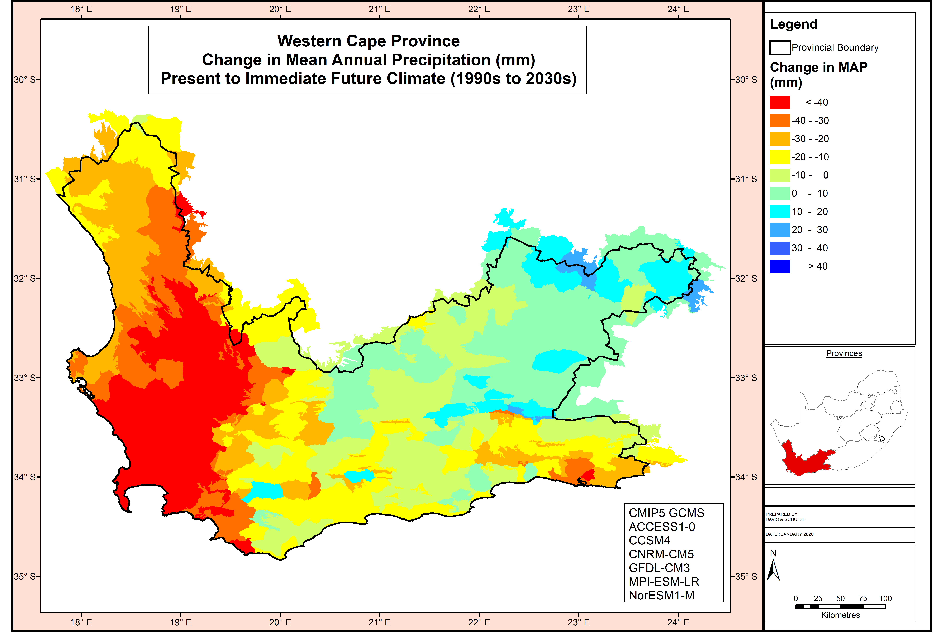
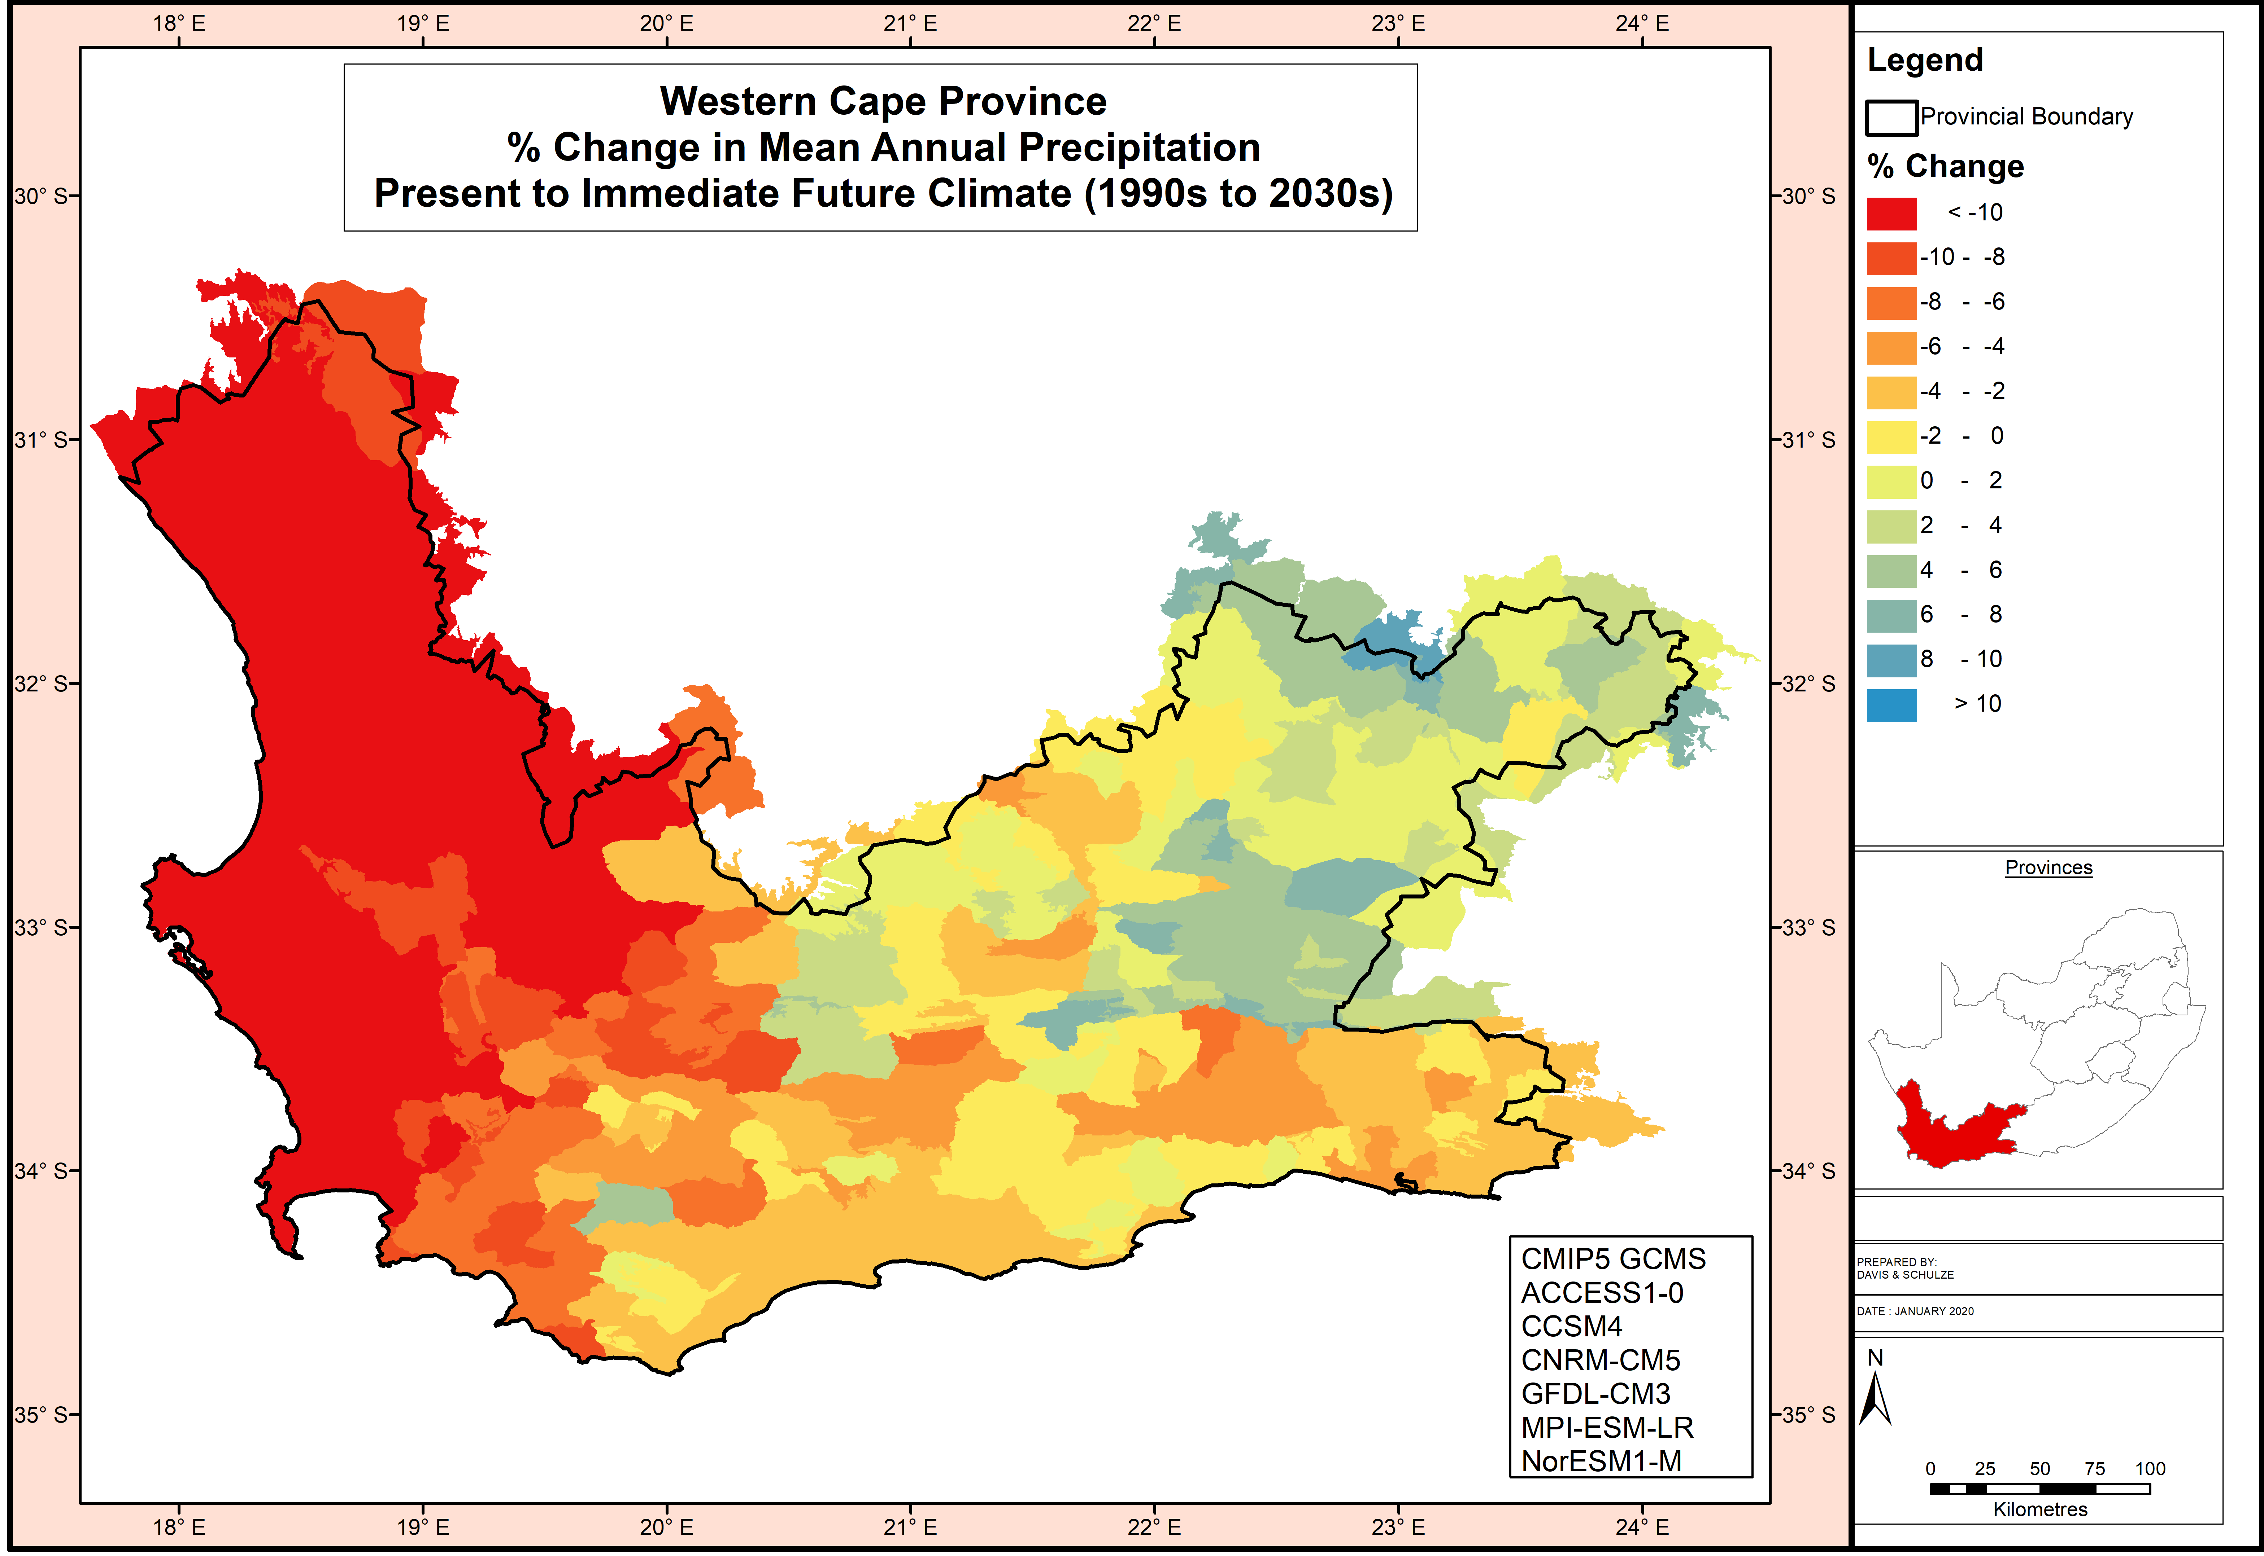
Modelled Annual Rainfall (7 models)
MAP is projected to decrease by >40mm per annum in large parts of the west, and by 10-20 mm in the south.
In the north-east, MAP is projected to increase by 10-20 mm.
In large parts of the central region, absolute changes (in mm) do not deviate much from zero (no change).

Slide 22
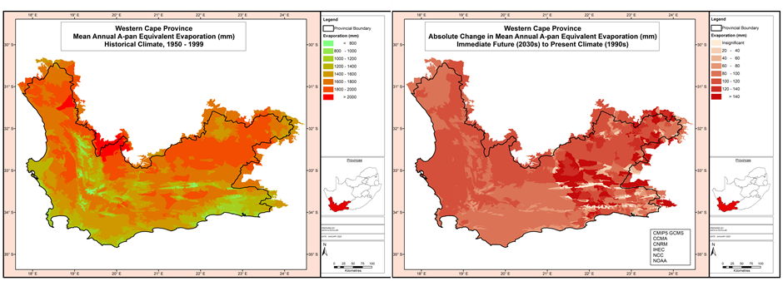
Modelled Annual Ref. Potential Evaporation (6 models)
Mean annual A-pan equivalent reference potential evaporation:
Projections show annual increases from as little as 20 mm in the eastern mountains to > 140 mm in the eastern Karoo (right map).
Over most of the agricultural areas, the projected annual increases into the immediate future are in the range 70-120 mm.

Slide 23
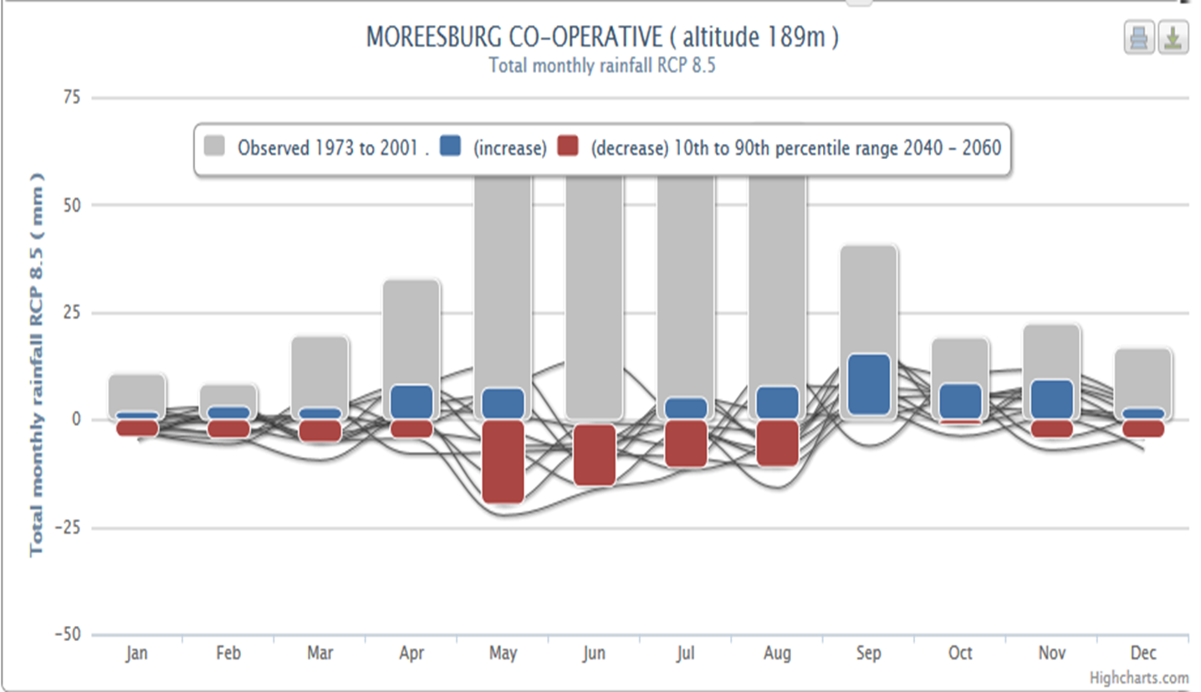

Modelled Rainfall Changes: 2050

Slide 24
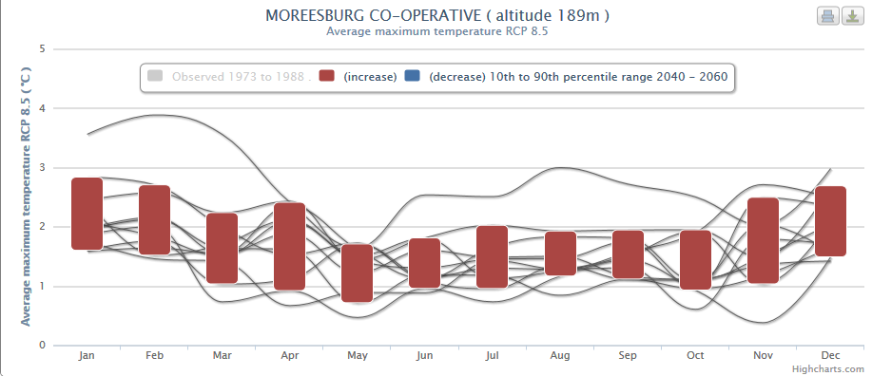
Modelled Changes in Maximum Temperature: 2050

Slide 25
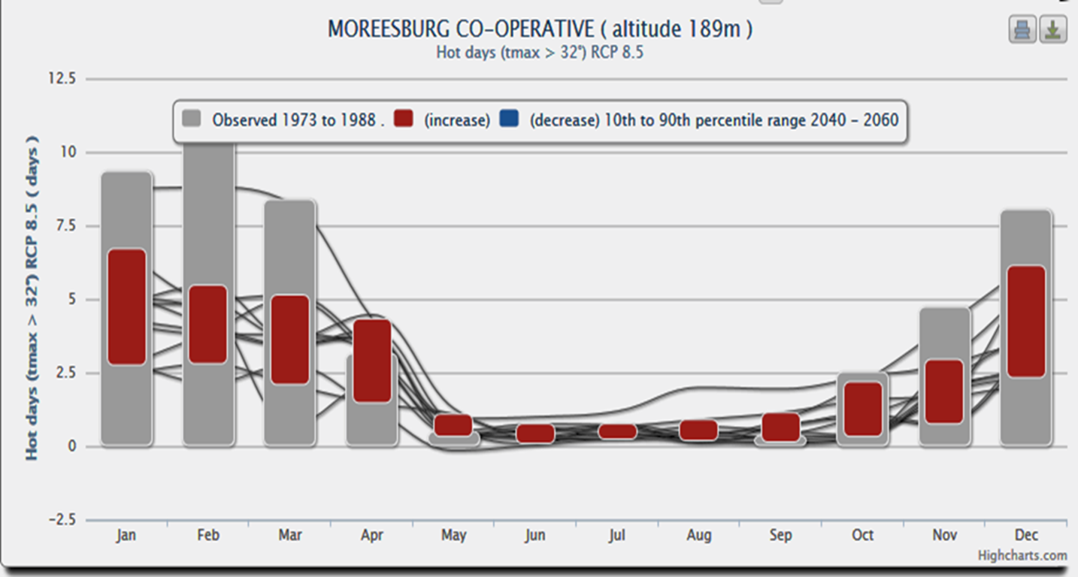
Additional number of hot days > 32°C: 2050

Slide 26
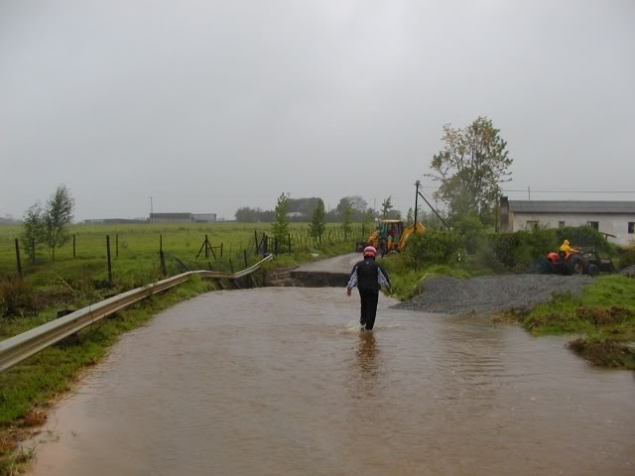

Severe weather events: increasing out to 2050
More heat stress
More frequent and longer dry spells
More heavy rainfall and floods
Possible changes in hail and strong winds
Increasingly favourable conditions for wildfires

Slide 27
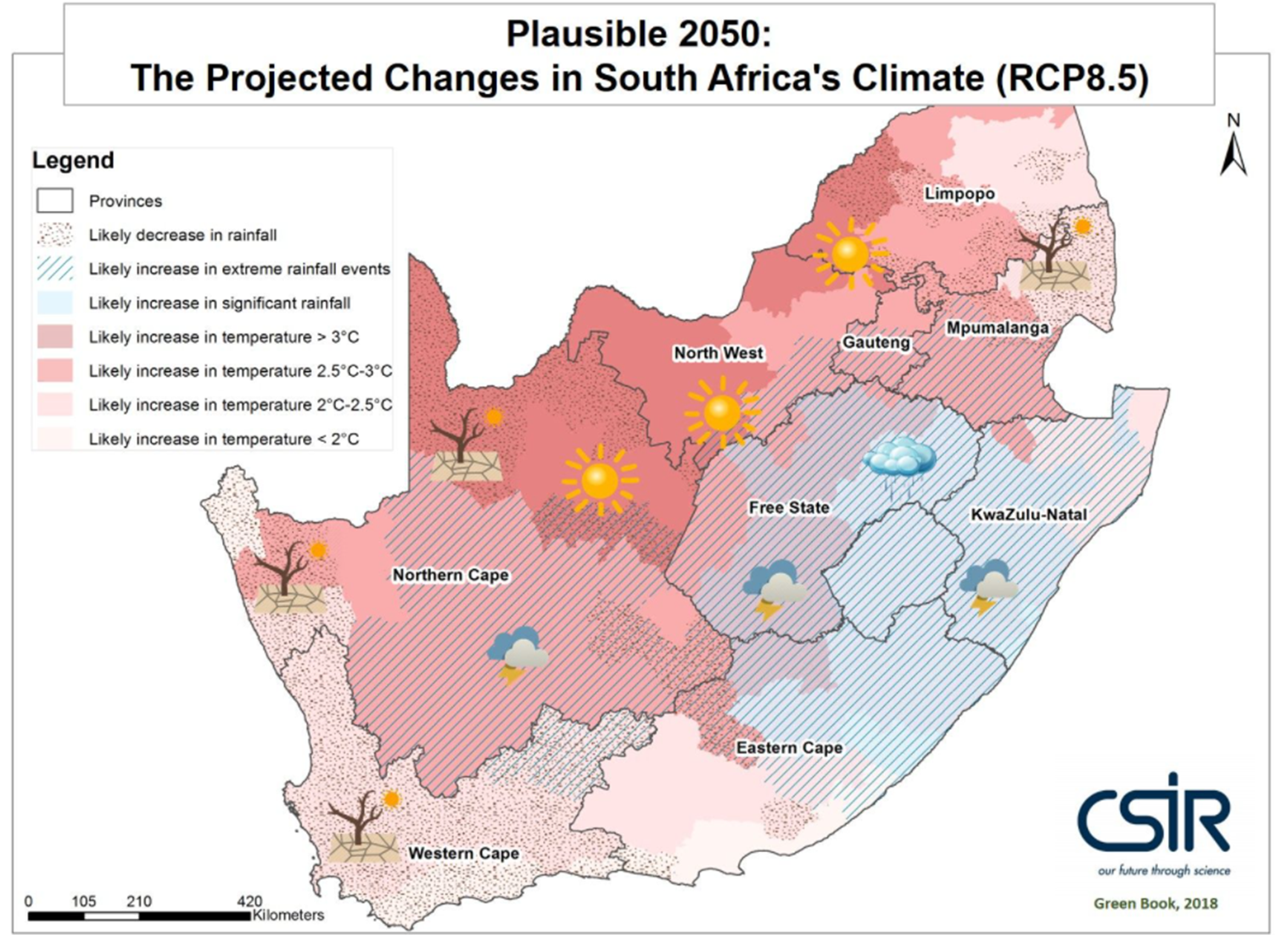

Slide 28
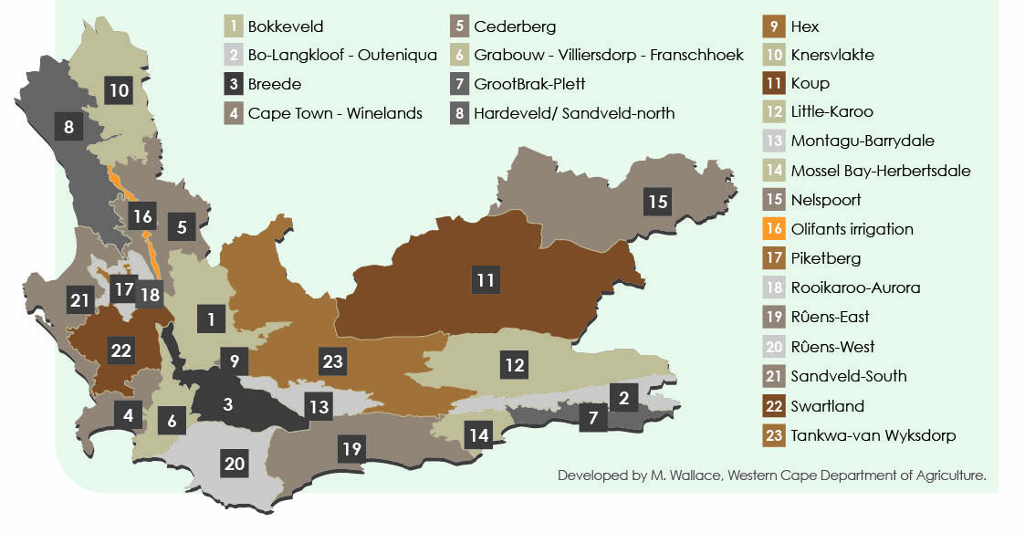
Future potential: Dryland Crops and Livestock
Drier winter & wetter spring; more variable grazing; increasing heat stress; prone to drought; some areas increasingly marginal; water scarcity

Slide 29
Future potential: Dryland Crops and Livestock
Milder climatic changes and will remain cooler region; drier winter but possible shifts into shoulder seasons and possible annual increases; prone to rainfall extremes; lack of water infrastructure

Slide 30
Summary of knowledge on dryland crop impacts in SA
  Very wide range of possible impacts on the average annual yield of non-irrigated crops by 2050.
  The impact on maize and wheat yields ranges from a reduction in the total national yield of 25% to a potential increase of 10% depending on GHG emissions reductions.
  Similar results are obtained for other crops with the exception of sugarcane and sorghum which show potential yield increases in many areas.
  West Coast: rooibos at risk in the north.
  A doubling of CO₂ concentrations could offset much of the negative impacts associated with a 2°C temperature rise, especially in core areas of production.

Slide 31
What can farmers do to adapt?
  Improved and adapted cultivars
  New species that are more adapted
  Flexible planting times
  Soil and nutritional management
  Conservation agriculture, Regenerative agriculture
  Precision farming and fine-scale mapping
  Pest and disease monitoring and management
  Risk reduction & management (drought planning)
  Diversify (crop-livestock, agri-tourism etc.)

Slide 32
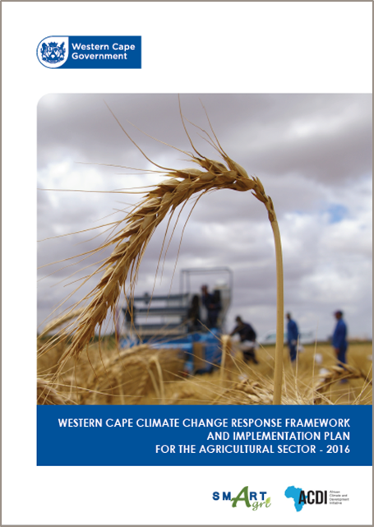
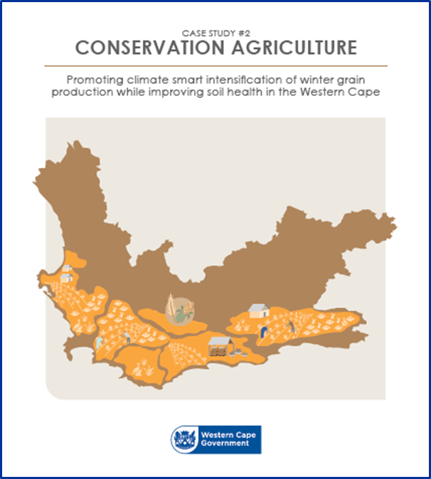
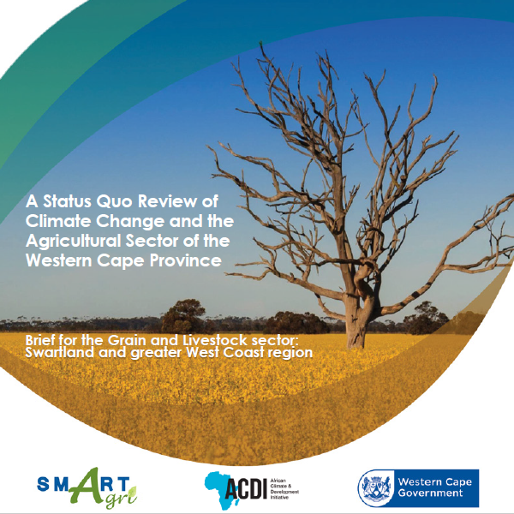
SmartAgri Plan (2014-2016) and Implementation
  Joint initiative between WC-DOA and WC-DEA&DP
  Western Cape Climate Change Framework and Implementation Plan for the Agricultural Sector
  Provides a “roadmap” to ensure a low-carbon, climate-resilient agricultural sector in the WC
  2016-2020 - Implementation:
  Support to Provincial drought response – Drought Dialogue (2016) confirmed alignment of SmartAgri Plan with sector challenges and needs
  Weekly “Die Kwik Styg” radio series for 2 years;
  Booklets
  Quarterly e-newsletter (SmartAgri Barometer)
  Implementation of 3 priority projects
  Embedding of Climate Smart Agriculture in WC-DOA and sector
www.greenagri.org.za

Slide 33
Six Priority Projects
Selected to catalyze the early adoption of important climate change response interventions with high impact, and accelerate the implementation of SmartAgri.
PP #1: Conservation Agriculture for all commodities and farming systems
PP #2: Restored ecological infrastructure for increased landscape productivity, socio-ecological resilience and soil carbon sequestration
PP #3: Collaborative integrated catchment management for improved water security (quality and quantity) and job creation
PP #4: Energy efficiency and renewable energy case studies to inspire the transition to low-carbon agriculture
PP #5: Climate-proofing the growth of agri-processing in the Western Cape
PP #6: Integrated knowledge system for climate smart agricultural extension

Slide 34
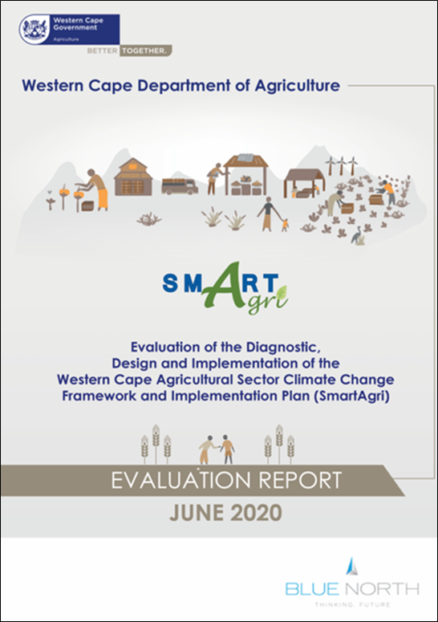
SmartAgri Implementation, External Evaluation, Way Forward
  2020 – External programme evaluation:
  Despite thorough sectoral consultation & awareness raising, lack of knowledge of the plan and its details among key stakeholder groupings
  Clear evidence of the institutionalization of the plan within WC-DOA and WC-DEA&DP, but some areas need strengthening
  Areas of greater versus lesser progress in the implementation of the plan at the level of projects, objectives and Strategic Focus Areas.
  7 Recommendations
  2021 – Way forward:
  Appointment of Prof. Stephanie Midgley
  Management Improvement Plan (2021)
  Establishment of operational structure
  Institutionalization
  Re-engagement with stakeholders

Slide 35
What next for SmartAgri?
Recommendation 6
Re-engage and strengthen uptake by Industry organisations and role players identified in the SmartAgri Plan
  Re-engagement on the SmartAgri Plan with sectoral role players
  This includes the research community and commodity organisations
  Support the information and coordination needs of this community
  Monitor the implementation efforts and impacts of the sectoral role players

Slide 36
What next for SmartAgri?
Recommendation 7
Adopt mechanisms to identify and mainstream farm-level innovation, learning and change
  Make updated SmartAgri resources and tools available to farmers through widely known portals:
        www.greenagri.org.za and www.elsenburg.com
  Develop a database for capturing climate change adaptation/ mitigation innovations and learning at farm and enterprise level, per agro-climatic zone
  Scope and evaluate different risk-assessment tools that can aide farmers to identify systemic risks and define the ‘improvement pathways’ towards greater resilience appropriate to their farms
  Begin a process of engaging with farmer forums to raise awareness of the available resources and to document the local innovations / learning.

Slide 37
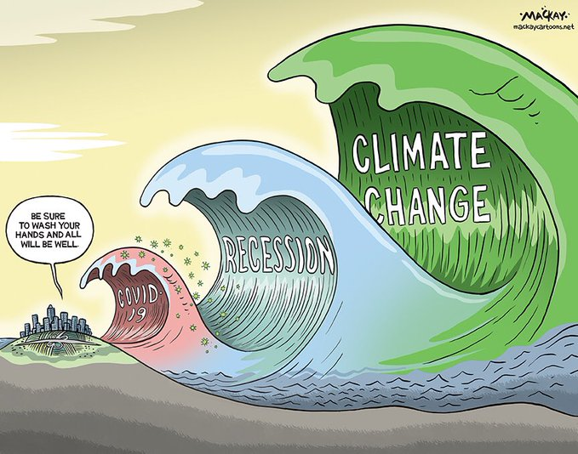
Significant events since 2016 – altered risk perceptions?

Slide 38
Closing thoughts on changing risk profiles
  Bring climate change risk into all spheres of investment planning, especially medium and longer term investments
  Climate change will influence local and global market dynamics (supply/demand, carbon footprint) – responsiveness and flexibility needed
  Proper planning, resourcing and implementation of disaster relief
  Viable financial and insurance mechanisms to incentivize proactive disaster risk reduction and the transition to resilience
  Adjustment in risk management across the value chain
Vulnerability
Hazard
RISK
Exposure
A new balance needs to be struck between measures to reduce risk and share risk, and effectively prepare for and manage disaster impact in a changing climate

Slide 39
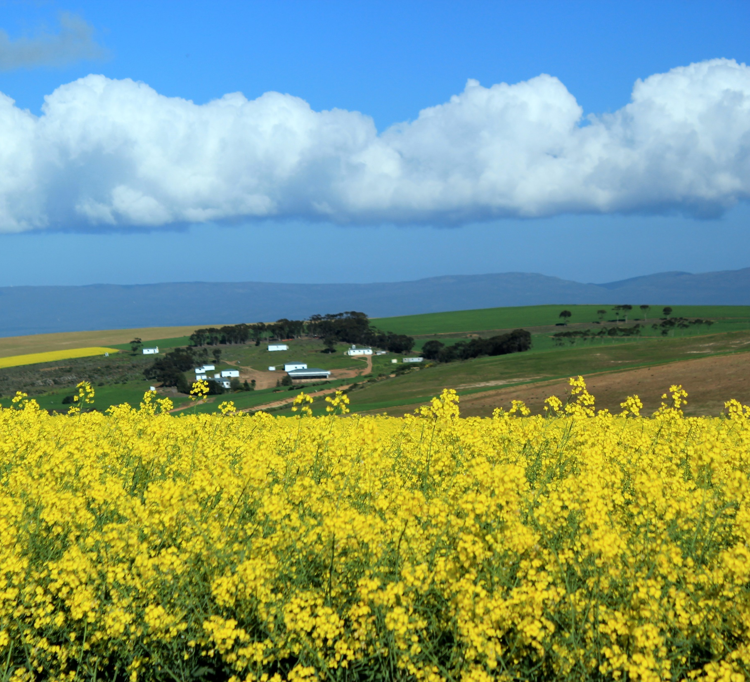

Thank You
stephaniem@elsenburg.com
www.greenagri.org.za

